Slide 1
Final Project Presentation
INSURANCE CLAIM PREDICTION

Slide 2
GOAL
The goal of our project is to develop a classification model that predicts whether a customer will file an insurance claim during the policy period. This is achieved by analyzing a dataset containing customer demographics, driving history, vehicle details, and other factors to:
Identify Key Features: Understand which factors most strongly influence claim likelihood (e.g., credit score, past accidents).
Build Predictive Models: Use machine learning algorithms like Logistic Regression, Decision Tree, and Random Forest to predict claim outcomes accurately.
Provide Business Insights: Generate actionable recommendations to optimize risk management, pricing strategies, and customer engagement for the insurance company.

Slide 3
Introduction and Background
Business Question:
How can we predict if a customer will file an insurance claim during the policy period, and which factors contribute most to claim likelihood?
Background and Context:
Industry Challenge: Insurance companies face challenges in managing risk and optimizing premiums due to unpredictable claim patterns. Misjudgment in pricing can lead to losses or missed revenue opportunities.
Current Practices: Many insurers rely on manual or outdated methods to assess risk, which may overlook subtle patterns in customer behavior or vehicle characteristics.
Data Opportunity: With access to customer demographics, vehicle details, and driving history, machine learning provides an opportunity to build predictive models that improve accuracy and efficiency in risk assessment.

Slide 4
Introduction and Background
Project Objectives:
Predict Claims: Develop a robust machine learning model to predict whether a customer will file an insurance claim.
Identify Influential Factors: Understand the key variables that contribute most to claim likelihood.
How the Model Addresses the Business Question:
Model Output:
The classification model predicts whether a claim will be filed (Yes/No).
High Recall ensures most claims are correctly identified, minimizing undetected risks.
High Accuracy ensures overall reliability of predictions, avoiding misclassification.
Insights Derived:
Identifies key risk factors like credit_score and violations_accidents.
Categorizes customers into risk profiles based on prediction probabilities.

Slide 5
ANALYSIS OF DATASET
Structure: Total rows: 10,000 , Total columns: 18 (including target variable outcome).
Feature Types:
Numeric: age, income, credit_score, annual_mileage.
Categorical: gender, vehicle_type, education.
Binary: marital_status, vehicle_year (converted).
Feature Analysis - To address the missing values in credit score and annual mileage, we imputed the missing data using the mean of each respective feature. Additionally, we removed the postal code and ID variables from the dataset, as they showed no significant correlation with the target variable or other key features. These preprocessing steps helped improve the data quality and model performance.
Numerical Features | Categorical Features
credit_score: Higher credit scores seem less associated with claims. age: Younger drivers appear to file more claims. annual_mileage: Higher mileage correlates with higher claim probability. | vehicle_type: Sports cars exhibit a higher claim rate. driving_experience: Inexperienced drivers are more likely to file claims.

Slide 6
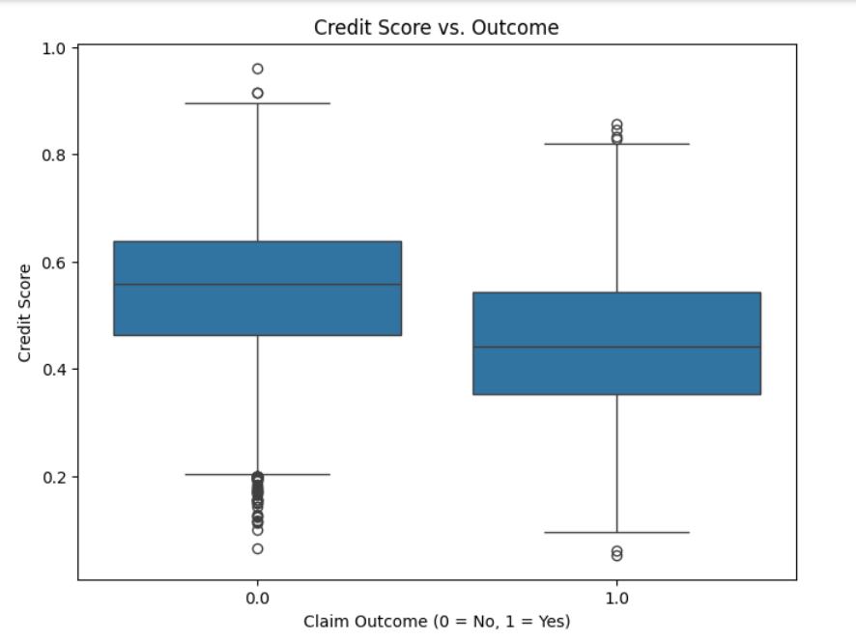
BIVARIATE ANALYSIS
1. Credit Score vs. Outcome
Insights:
Customers with lower credit scores are
more likely to have an insurance claim (outcome = 1).
Higher credit scores are concentrated among
customers who did not file a claim (outcome = 0).
Significance: Credit scores could be a strong predictor
of claims. Lower scores may indicate financial risk,
correlating with a higher likelihood of accidents or claims.

Slide 7
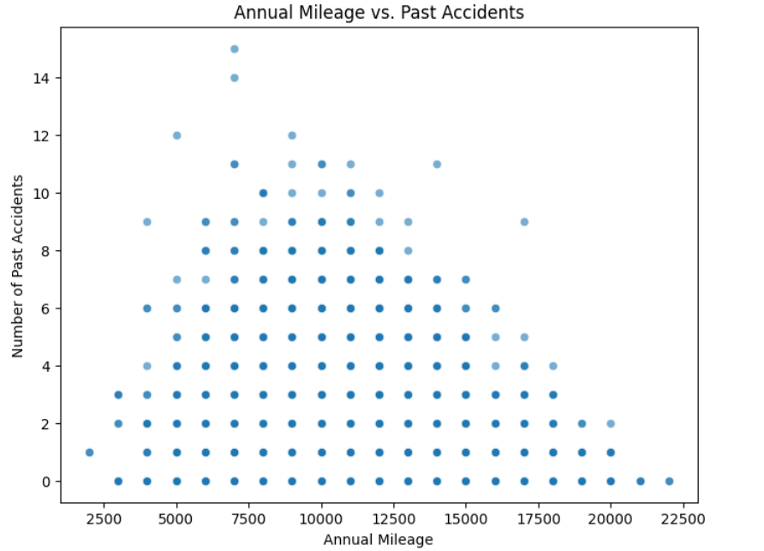
BIVARIATE ANALYSIS
2. Annual Mileage vs. Past Accidents
Insights:
There is no clear linear relationship between annual
mileage and past accidents.
Some clustering may indicate more accidents
among drivers with moderate mileage
(10,000–15,000 miles).
Significance: While mileage alone may not strongly
predict accidents, moderate mileage could be an
indirect indicator of risk, such as frequent but cautious driving.

Slide 8
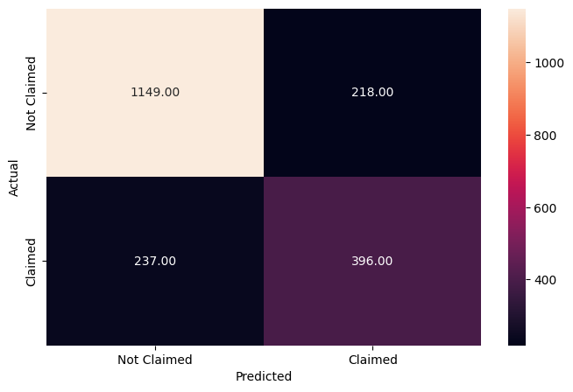
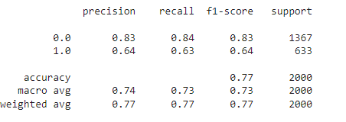
Decision Tree Classifier
The model achieves moderate accuracy (77%) but shows signs of class imbalance:
Precision and recall for "Attrite" (Class 1) are significantly lower than for "Not Attrite" (Class 0).
False Negatives (237) suggest that the model struggles to identify all cases of attrition, a critical issue in some use cases.
Notes:
Key Takeaways
Overfitting Issue: The model performs significantly better on training data compared to testing data, indicating overfitting.
Apply Random Forest for more robust generalization.
Tune hyperparameters to reduce False Negatives.

Slide 9
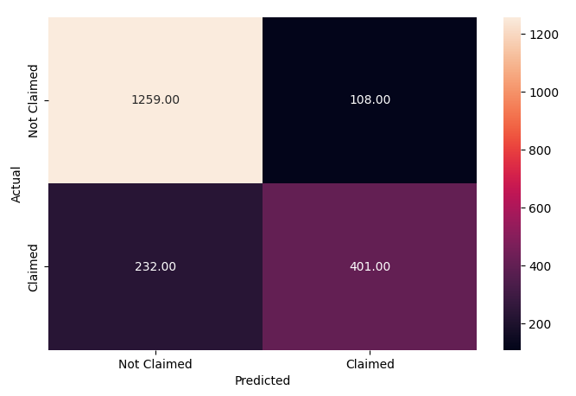
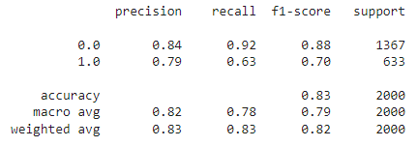
Random Forest Classifier
The model achieves low recall (63%) and moderate precision (79%) for the "Claimed" class.
Lower recall (63%) for the "Claimed" class indicates the model is missing some true "Claimed" instances.
Overall Accuracy: A strong 83% accuracy, balancing both classes.
Notes:
Strengths:
The model performs well in predicting "Not Claimed" instances.
Weighted metrics indicate robust overall performance.
Challenges:
The model struggles with False Negatives in the "Claimed" class, leading to lower recall.
Next Steps:
Improve performance for the minority class (Claimed) by:
Using class balancing techniques.
Exploring alternative models (logistic regression) or hyperparameter tuning.

Slide 10
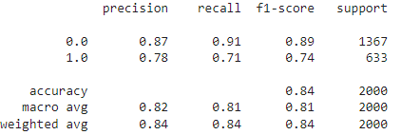
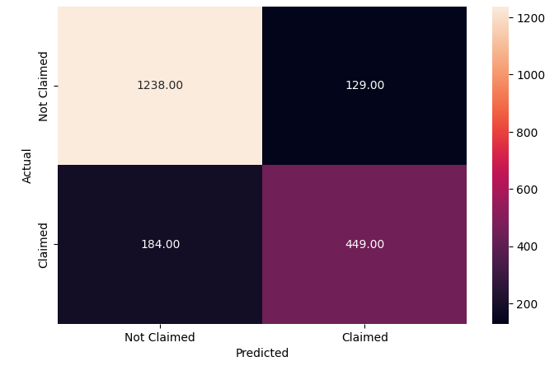
Logistic Regression
The model achieves high recall (91%) and high precision (87%) for the "Not Claimed" class.
Compared to prior models, this logistic regression model performs better for the "Claimed" class, achieving a 71% recall and a 74% F1-score.
The weighted averages across metrics indicate strong general performance.
Notes:
Best Model Performance: Logistic Regression achieved the highest recall and accuracy among all models tested on the dataset.
Challenges Remaining: False Negatives (184) remain an area of focus for the "Claimed" class.
Next Steps: Further improvements could include class balancing or hyperparameter tuning to minimize False Negatives further.

Slide 11
Results Comparison
Logistic Regression is the preferred model as it balances precision and recall effectively, making it the best-performing model for this dataset.
Balanced performance metrics: Best recall (71%) and F1-score (74%) for the "Claimed" class.
Performs consistently across training and test datasets, indicating low overfitting.
Actionable insights: Model coefficients provide valuable interpretability for decision-making.
Random Forest is close in performance but slightly lower.
Decision Tree trails behind in all metrics.

Slide 12
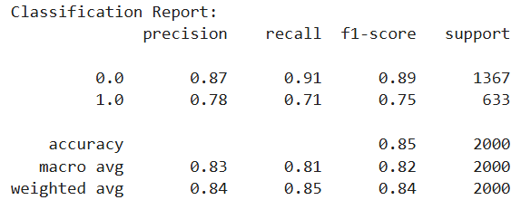

ENSEMBLE METHODS
We used a Bagging Classifier and performed cross validation to improve model performance.
We see a slight improvement in accuracy (85%) while maintaining recall value at 71%.

Slide 13
Suggestions for improvement
Outlier Analysis and pre-processing - Studying and addressing outliers could give the business some context on what can be expected and general trends.
Other Ensemble Methods - Bagging was used, but Voting could have performed better on the dataset.
Including more data – since the dataset is heavily imbalanced towards “Not claimed”, we could improve model performance by using more data.

Slide 14
Business Recommendations
Risk-Based Pricing - The model identifies high-risk customers based on features like credit score, speeding violations, and claim history.
Recommendation:
Implement dynamic premium pricing: Charge higher premiums for high-risk customers while offering discounts to low-risk customers to remain competitive.
Provide risk-reduction incentives (e.g., safe driving discounts) to encourage responsible behavior among high-risk groups.
2. Fraud Detection and Prevention - The model could flag patterns or characteristics often associated with fraudulent claims.
Recommendation:
Use the model to create a claim triage system, where high-risk claims are flagged for further investigation, reducing costs associated with fraud.
Invest in technology and training for adjusters to better handle flagged claims.

Slide 15
Business Recommendations
3. Prevention and Customer Education - Factors like speeding violations and past accidents are significant predictors of claims.
Recommendation:
Launch educational campaigns:
Promote safe driving habits among customers with incentives like reduced premiums for no speeding violations.
Offer training programs or workshops for fleet customers to lower their claims risk.
Partner with telematics providers (e.g., GPS or driving behavior trackers) to monitor driving habits and offer proactive risk mitigation.

Slide 16
Thank you

